Slide 1
WELCOME TO PROJECT 04 PRESENTATION

Slide 2




SUBMITTED BY :-
z
JOSH MARTIN
ARCHANA KARRI
UDESHI PEREIRA

Slide 3

HYPOTHASIS
z

Slide 4
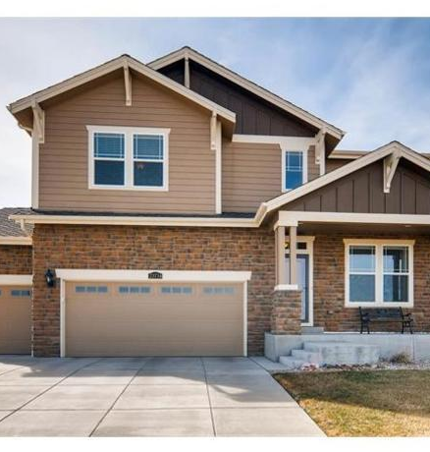
RENTAL HOUSE PRICE PREDICTION MODEL
z

Slide 5
OUTLINE
Abstract
Introduction
Goal
Purpose
Project Summary
ETL & Modelling
Models Used
Analysis & prediction

Slide 6

ABSTRACT
Real estate in least transparent industry in our ecosystem.
Rental prices increase every year, so there is a need for a system to predict house prices in the future.
Predicting Rental Prices with real factors.
We aim to make evaluations based on every basic parameter that is considered while determining the price

Slide 7
INTRODUCTION
Machine learning algorithms are being used for multiple real-life applications and in research. As a result of digital technology, large structured and georeferenced datasets are now more widely available, facilitating the use of these algorithms to analyse and identify patterns, as well as to make predictions that help users in decision making. This research aims to identify the best machine learning algorithms to predict house prices,

Slide 8
Implement a machine learning model capable of predicting the house rent for homes. Determine the essential features significantly needed to predict the house rent for homes.
GOAL

Slide 9
PURPOSE In recent times, finding the ideal housing option according to budget and preferences is such a hassle. The cost of house rent depends on many factors such as; the house size, number of bedrooms, locality, number of bathrooms, halls, and kitchen, furnishing status, and a lot more. With the use of appropriate machine learning algorithms, real estate owners can find the ideal house according to customers’ budgets and preferences with ease.
z

Slide 10
z
PROJECT SUMMERY
Our Project is a machine learning model, based on certain specifications of your future home it will try to guess the most accurate price.
Information such as state, city, area etc.

Slide 11

The basic procedures implemented to achieve the goals of this research are:
1. Data collection
2. Data cleaning an exploration
3. Feature encoding
4. Train-test split validation
5. Feature scaling
6. Modelling
7. Model evaluation
z

Slide 12
Data collection
The dataset used in this project was obtained from Kaggle. It has information on about 4700+ houses available for rent with different parameters ranging from; size to the number of bedrooms, halls, and kitchens to the locality, and furnishing status, among others.

Slide 13
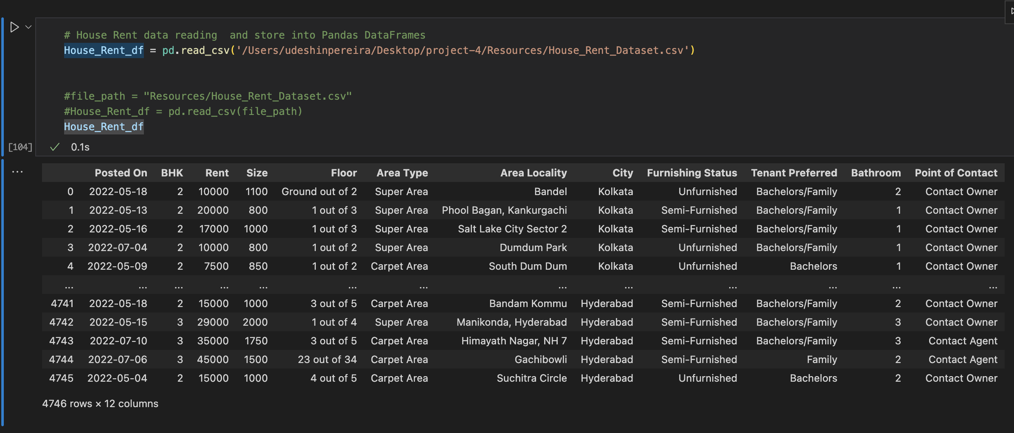

Slide 14
Data cleaning and exploration
After appropriate checking, we discovered that the dataset is void of null and duplicate values. This depicts that the dataset is kind of clean from the onset.

Slide 15
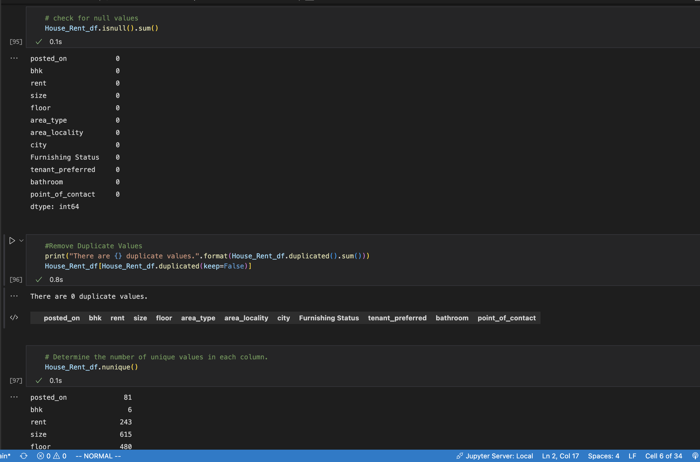

Slide 16
Going further, We explored the data to check if there are trends between the explanatory variables and the target variable.

Slide 17
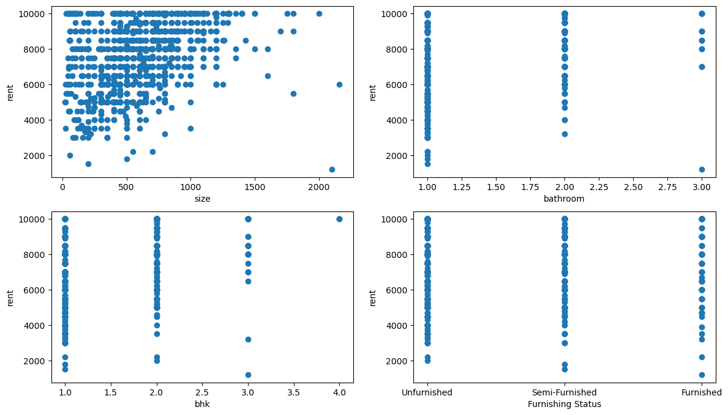

Slide 18
We have noticed an extreme value for the target variable but we decided not to remove it. This is because it is possible to have extremely high house rent.
Checking the data types of most of the columns, we discovered that most of the features are categorical. This leads to the next step.

Slide 19
Feature Encoding
The categorical features have to be converted to numerical features for efficient modelling. Further examination shows that the categorical features have pretty much labels, therefore using one hot encoding will likely lead to high dimensionality. Therefore, Scikit-learn’s label encoder was used to encode the features.

Slide 20
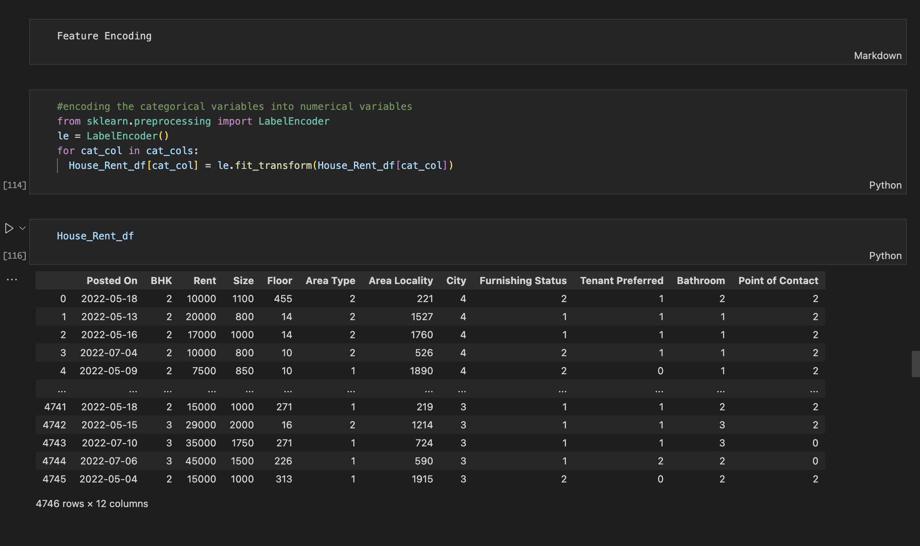

Slide 21
After encoding the features, We decided to visualize the correlation of the features as shown on the heat map below.

Slide 22
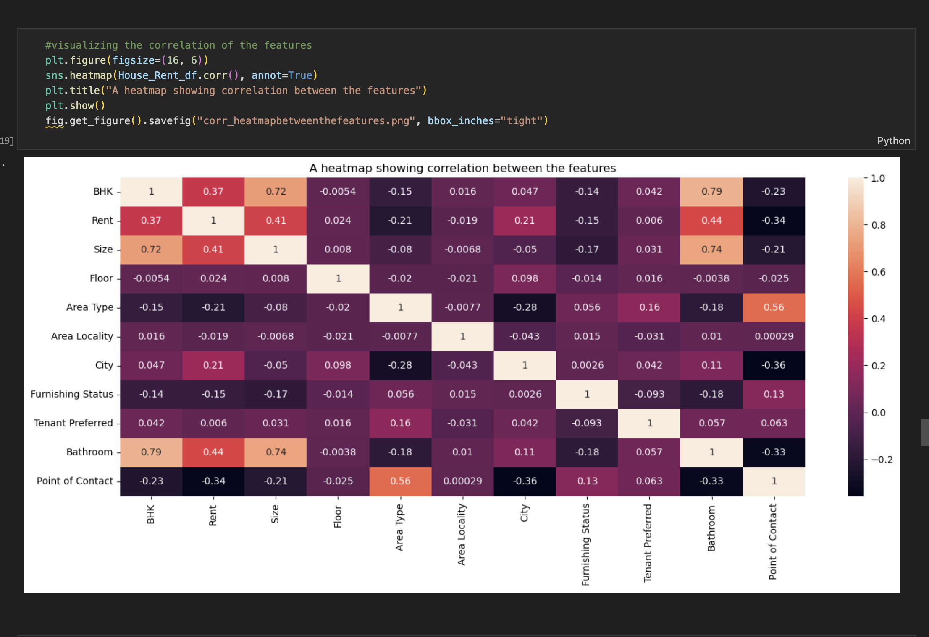

Slide 23
Train-test split validation
The dataset is split into explanatory variables — X and target variable — y. Then, further, split into train and test data in ratio 70:30 respectively. Splitting the data helps to assess the model’s performance on unseen data after being trained on the training data. Scikit-learn’s train-test split is used to accomplish this task.

Slide 24
Feature scaling
Before going into modeling proper, the data needs to be scaled to handle skewed features. Scikit-learn’s standard scaler ensures that for each feature the mean is 0 and the variance is 1, bringing all the features to the same magnitude. Doing this will significantly affect the model’s performance.

Slide 25
MODELLING
z
JOSH MARTIN

Slide 26
Machine Learning Model Building Pipeline: Data Analysis
In this following notebook, we will go through the Data Analysis step in the Machine Learning model building pipeline. There will be a notebook for each one of the Machine Learning Pipeline steps:
Data Analysis
2. Feature Engineering
3. Model Building
This is the notebook for step 1: Data Analysis
The dataset can be found in
Predicting Rent Price of Houses
The aim of the project is to build a machine learning model to predict the rent price of homes based on different explanatory variables describing aspects of residential houses.
What is the objective of the machine learning model?
We aim to minimise the difference between the real rent and the rent estimated by our model. We will evaluate model performance using the mean squared error (mse) and the root squared of the mean squared error (rmse).

Slide 27
MODELL EVALUATION

Slide 28
ANALASYS & FINAL PREDICTS

